Slide 1
Module 3 Topic I Hydrogen refuel Infrastructure

Slide 2
HYDROGEN REFUELLING INFRASTRUCTURE

Slide 3
TYPES OF HYDROGEN REFUELLING STATION (HRS)
Types | Method
Off-site hydrogen recharging station (Hydrogen supplied from Hydrogen produced from an external source) | Hydrogen supplied from an external source hydrogen produced from a plant is supplied via pipelines, tube trailers, etc.
On-site hydrogen recharging station (Hydrogen produced directly at the station) | Hydrogen produced by extracting (reforming) natural gas, electrolysis, etc. at the directly at the station) recharging station

Slide 4
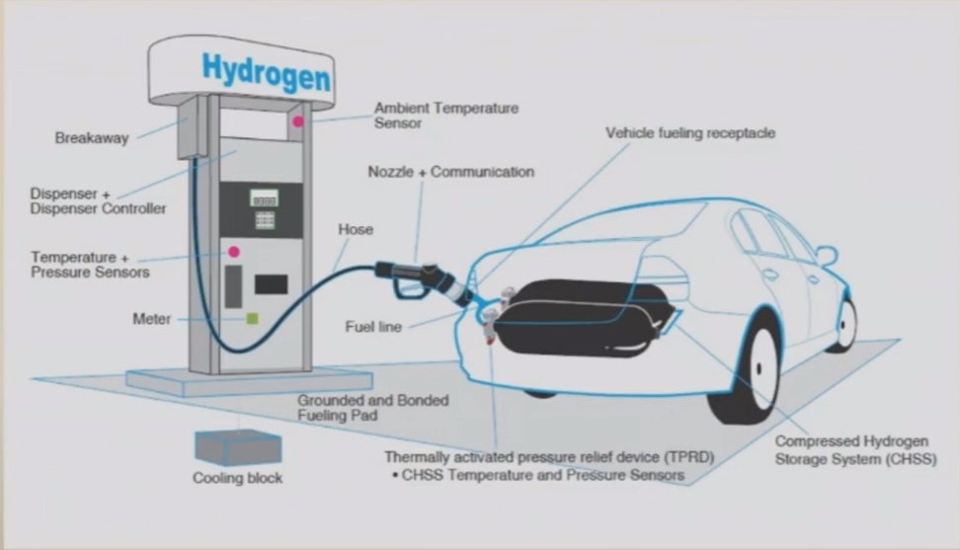

Slide 5
REFUELLING STATION: SPECIFICATIONS
Gas detection sensors for immediate
leak detection
Breakaway connectors
Reinforced polycarbonate upper door
with ergonomic design to provide
simple, customer-friendly
user interface
Energy-efficient display panel with LED
backlighting for clear visibility of
display in all lighting conditions; all
displays equipped with clear, hard-
coated sacrificial lenses for increased
durability and extended life
Debit payment system and LED display
with on-screen training instructions for
first-time users
Durable keypad
Credit card reader
Emergency stop button and operating
instructions
H70 and H35 unit price displays
Unique fueling pressure selection buttons
with no moving parts for unmatched
durability
Lower door assembly
RFID (radio frequency identification
detector) reader for vehicle identification
and communications
Protective jackets over hoses

Slide 6
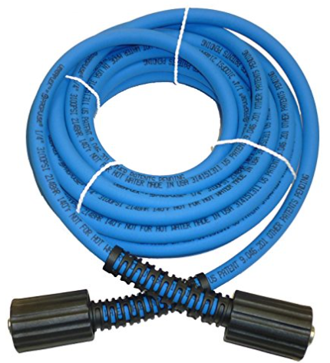
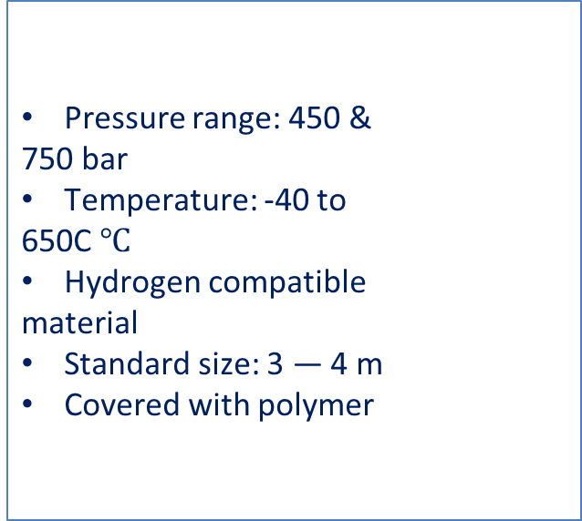
HOSE SPECIFICATION
Pressure range: 450 &
750 bar
Temperature: -40 to
650C $℃$
Hydrogen compatible
material
Standard size: 3 — 4 m
Covered with polymer

Slide 7
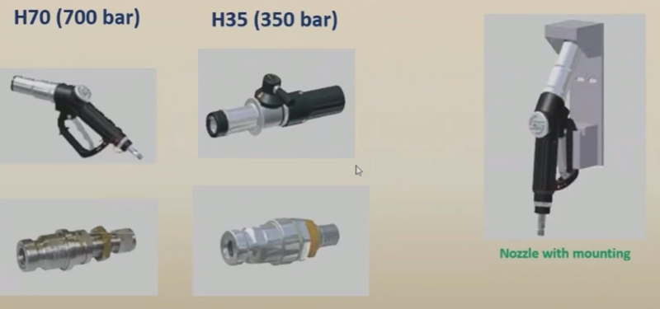
Nozzle with mounting

Slide 8
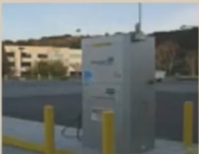
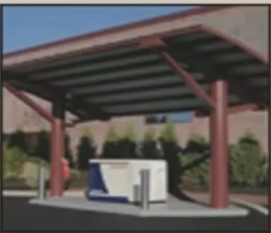
GLOBAL HYDROGEN FUELING STATION SCENARIO
More than 100 hydrogen fueling stations in
operation globally
US, Germany, Japan and Canada have majority
of stations
Electrolyser based system
Most of these dispensing stations are either
electrolyser or SMR based
Majority of stations dispense compressed
gaseous hydrogen or H-CHG. Some stations
dispense liquid hydrogen
SMR based system

Slide 9
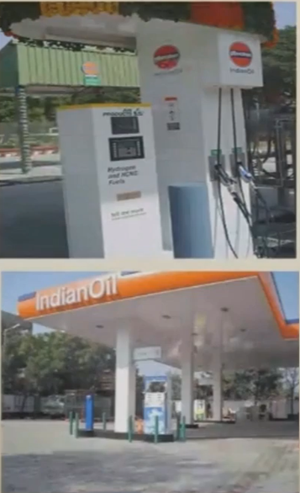
HYDROGEN DISPENSING STATIONS- INDIA
An electrolyser based hydrogen production
and H-CNG dispensing station was set up by
IOCL at Faridabad in 2005
IOCL set up another H-CNG dispensing station
(5 Nm3/h, i.e. 11 kg/day, 24 hrs operation) at
Dwarka, New Delhi with partial financial
support from MNRE in March, 2009
IOCL has one PEM electrolyser based hydrogen
production (30 Nm3/h capacity) & dispensing
station at Faridabad for refuelling of Tata
Motors' 2 fuel cell buses
NISE has one Alkaline electrolyser based
hydrogen production (5 Nm3/h capacity) &
dispensing station at Gurugram for refuelling
of M&M's Hydrogen- Diesel Dual Fuel Scorpio

Slide 10
Thank you

